Slide 1
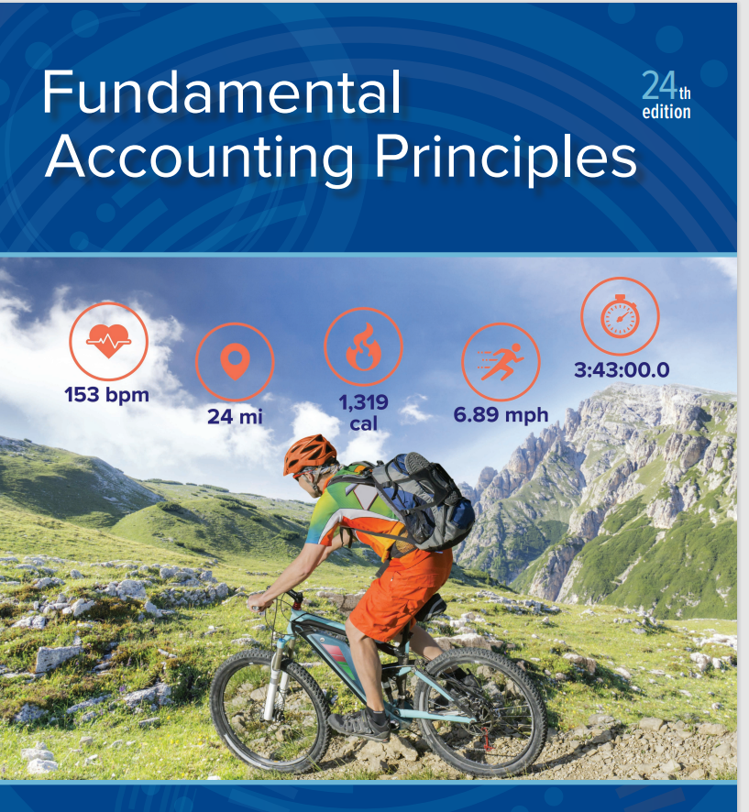
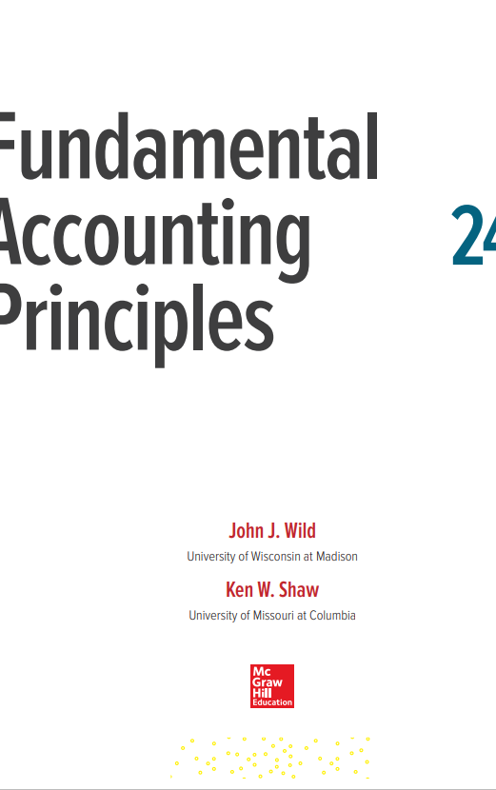

Slide 2

Slides Prepared by:
Professor Mohammad Kashem
Department of MIS
University of Dhaka
Dhaka

Slide 3
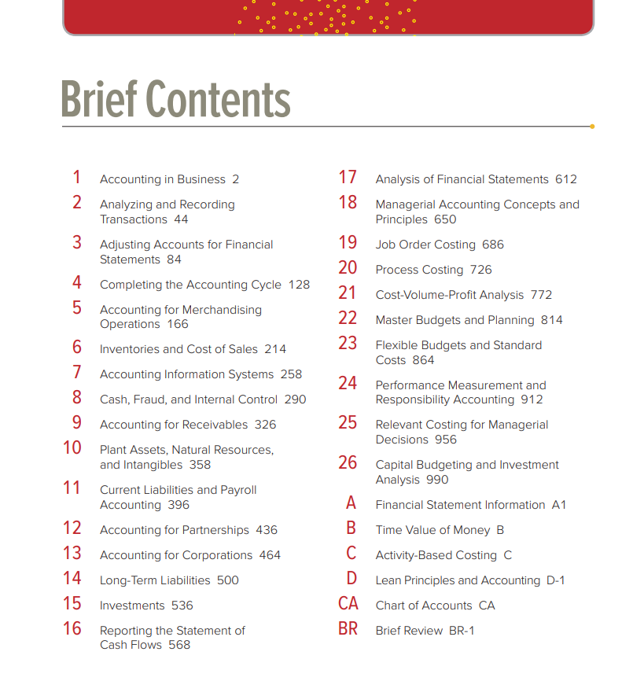

Slide 4
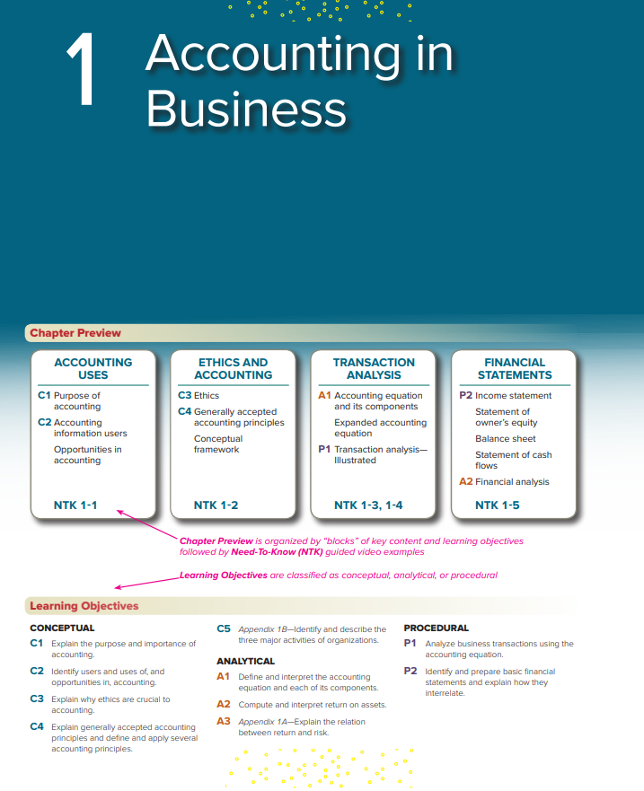

Slide 5
Learning Objectives (1 of 2)
CONCEPTUAL
C1 Explain the purpose and importance of accounting.
C2 Identify users and uses of, and opportunities in, accounting.
C3 Explain why ethics are crucial to accounting.
C4 Explain generally accepted accounting principles and define and apply several accounting principles.
C5 Appendix 1B Identify and describe the three major activities of organizations.

Slide 6
Learning Objectives (2 of 2)
ANALYTICAL
A1 Define and interpret the accounting equation and each of its components.
A2 Compute and interpret return on assets.
A3 Appendix 1A Explain the relation between return and risk.
PROCEDURAL
P1 Analyze business transactions using the accounting equation.
P2 Identify and prepare basic financial statements and explain how they interrelate.

Slide 7
Learning Objective C1: Explain the purpose and importance of accounting.

Slide 8
Exhibit 1.1 Importance of Accounting (1 of 2)
Learning Objective C1: Explain the purpose and importance of accounting.
Identifying
Select transactions and events
For example, the sale by Apple of an iPhone.
Recording
Input, measure, and log
Keep a chronological log of transactions.
Communicating
Prepare, analyze, and interpret
Prepare reports such as financial statements.
Notes:
Accounting is an information and measurement system that identifies, records, and communicates relevant, reliable, and comparable information about an organization’s business activities.
Identifying business activities requires that we select relevant transactions and events.
Recording business activities requires that we keep a chronological log of transactions and events measured in dollars.
Communicating business activities includes preparing accounting reports such as financial statements, which we analyze and interpret.

Slide 9
Exhibit 1.1 Importance of Accounting (2 of 2)
Learning Objective C1: Explain the purpose and importance of accounting.
Accounting is an information and measurement system that identifies, records, and communicates relevant, reliable, and comparable information about an organization’s business activities.

Slide 10
Learning Objective C2: Identify users and uses of, and opportunities in, accounting.

Slide 11
Exhibit 1.2 Users of Financial Information (1 of 3)
Learning Objective C2: Identify users and uses of, and opportunities in, accounting.
Accounting is called the language of business because all organizations set up an accounting information system to communicate data to help people make better decisions. Accounting serves many users who can be divided into two groups: external users and internal users.
Notes:
Accounting is called the language of business because all organizations set up an accounting information system to communicate data to help people make better decisions. Accounting serves many users, who can be divided into two groups: external users and internal users.
External users of accounting information are not directly involved in running the organization. They include shareholders (investors), lenders, directors, customers, suppliers, regulators, lawyers, brokers, and the press. External users have limited access to an organization’s information. Yet their business decisions depend on information that is reliable, relevant, and comparable.
Internal users of accounting information are those directly involved in managing and operating an organization such as the chief executive officer (CEO), chief financial officer (CFO), chief audit executive (CAE), treasurer, and other executive and managerial-level employees. They use the information to help improve the efficiency and effectiveness of an organization.

Slide 12
Exhibit 1.2 Users of Financial Information (2 of 3)
Learning Objective C2: Identify users and uses of, and opportunities in, accounting.
External users
Lenders
Shareholders
Governments
Consumer groups
External auditors
Customers

Slide 13
Exhibit 1.2 Users of Financial Information (3 of 3)
Learning Objective C2: Identify users and uses of, and opportunities in, accounting.
Internal users
Officers
Managers
Internal auditors
Sales staff
Budget officers
Controllers

Slide 14
Exhibit 1.3 Opportunities in Accounting (1 of 5)
Learning Objective C2: Identify users and uses of, and opportunities in, accounting
Opportunities in Accounting
Financial
Preparation
Analysis
Auditing
Regulatory
Consulting
Planning
Criminal investigation
Notes:
Accounting information is in all aspects of our lives. When we earn money, pay taxes, invest savings, budget earnings, and plan for the future, we use accounting.
The majority of opportunities are in private accounting, which are employees working for businesses. Public accounting offers the next largest number of opportunities, which involve services such as auditing and tax advice. Still other opportunities exist in government and not-for-profit agencies, including business regulation and investigation of law violations.
Accounting specialists are highly regarded. Their professional standing often is denoted by a certificate. Certified public accountants (CPAs) must meet education and experience requirements, pass an examination, and exhibit ethical character.
Review what you have learned in the following NEED-TO-KNOW Slide.

Slide 15
Exhibit 1.3 Opportunities in Accounting (2 of 5)
Learning Objective C2: Identify users and uses of, and opportunities in, accounting
Managerial
General accounting
Cost accounting
Budgeting
Internal auditing
Consulting
Controller
Treasurer
Strategy

Slide 16
Exhibit 1.3 Opportunities in Accounting (3 of 5)
Learning Objective C2: Identify users and uses of, and opportunities in, accounting
Taxation
Preparation
Planning
Regulatory
Investigations
Consulting
Enforcement
Legal services
Estate plans

Slide 17
Exhibit 1.3 Opportunities in Accounting (4 of 5)
Learning Objective C2: Identify users and uses of, and opportunities in, accounting
Accounting-related
Lenders
Consultants
Analysts
Traders
Directors
Underwriters
Planners
Appraisers
FBI investigators

Slide 18
Exhibit 1.3 Opportunities in Accounting (5 of 5)
Learning Objective C2: Identify users and uses of, and opportunities in, accounting
Marketing researchers
Systems designers
Merger services
Business valuation
Forensic accounting
Litigation support
Entrepreneurs
Accounting information is in all aspects of our lives. When we earn money, pay taxes, invest savings, budget earnings, and plan for the future, we use accounting.

Slide 19
NEED-TO-KNOW 1-1 (1 of 2)
Learning Objective C1: Explain the purpose and importance of accounting.
Learning Objective C2: Identify users and uses of, and opportunities in, accounting
Identify the following users of accounting information as either an (a) external or (b) internal user.
Regulator | a) External user
CEO | b) Internal user
Shareholder | a) External user
Controller | Internal user
Executive Employee | b) Internal user
External Auditor | a) External user
Production Manager | b) Internal user
Nonexecutive Employee | a) External user
Notes:
Identify the following users of accounting information as either an external or an internal user. External users are not directly involved in running the organization. Internal users of accounting information are directly involved in managing and operating an organization.
Regulators are not directly involved; they're external users. The CEO is very involved; he/she is an internal user. Shareholders are not directly involved in actually running the corporation; shareholders are external users. The controller is very involved in managing and operating an organization; the controller is an internal user. An executive employee is directly involved; he/she is an internal user. The external auditor is not actually running the organization; external auditors are external users. The production manager is directly involved in managing the organization; production managers are internal users. A nonexecutive employee, although they certainly have a stake in the organization, is not directly involved in running the organization; nonexecutive employees are external users.

Slide 20
NEED-TO-KNOW 1-1 (2 of 2)
Learning Objective C1: Explain the purpose and importance of accounting.
Learning Objective C2: Identify users and uses of, and opportunities in, accounting
External users of accounting information are NOT directly involved in running the organization.
Internal users of accounting information ARE directly involved in managing and operating an organization.

Slide 21
Learning Objective C3: Explain why ethics are crucial to accounting.

Slide 22
Exhibit 1.6 Ethics – A Key Concept (1 of 2)
Learning Objective C3: Explain why ethics are crucial to accounting.
The goal of accounting is to provide useful information for decisions. For information to be useful, it must be trusted. This demands ethics in accounting. Ethics are beliefs that distinguish right from wrong. They are accepted standards of good and bad behavior.
Notes:
The goal of accounting is to provide useful information for decisions. For information to be useful, it must be trusted. This demands ethics in accounting. Ethics are beliefs that distinguish right from wrong. They are accepted standards of good and bad behavior.
When faced with an ethical concern, the first step is to recognize it as such. Next, we should analyze all of our options (both good and bad). Finally, we must choose the best option after weighing all the consequences.

Slide 23
Exhibit 1.6 Ethics – A Key Concept (2 of 2)
Learning Objective C3: Explain why ethics are crucial to accounting.
Identifying ethical concerns
Use personal ethics to recognize an ethical concern.
Analyze options
Consider all good and bad consequences.
Make ethical decision
Choose best option after weighing all consequences.

Slide 24
Fraud Triangle
Learning Objective C3: Explain why ethics are crucial to accounting.
Three factors must exist for a person to commit fraud: opportunity, pressure, and rationalization.
Opportunity
Envision a way to commit fraud with a low perceived risk of getting caught
Rationalization
Fails to see the criminal nature of the fraud or justifies the action
Financial pressure
Must have some pressure to commit fraud, like unpaid bills
Notes:
The fraud triangle is a model created by a criminologist that asserts the following three factors must exist for a person to commit fraud: opportunity, pressure, and rationalization.
Opportunity. A person must envision a way to commit fraud with a low perceived risk of getting caught. Employers can directly reduce this risk. An example of some control on opportunity is a pre-employment background check.
Pressure, or incentive. A person must have some pressure to commit fraud. Examples are unpaid bills and addictions.
Rationalization, or attitude. A person who rationalizes fails to see the criminal nature of the fraud or justifies the action.
It is important to recognize that all three factors of the fraud triangle must usually exist for fraud to occur. The absence of one or more factors suggests fraud is unlikely. The key to dealing with fraud is to focus on prevention. It is less expensive and more effective to prevent fraud from happening than it is to try to detect the crime. By the time the fraud is discovered, the money is gone and chances are slim that it will be recovered. Additionally, it is costly and time-consuming to investigate a fraud.

Slide 25
Sarbanes–Oxley (SOX) (1 of 2)
Learning Objective C3: Explain why ethics are crucial to accounting.
Congress passed the Sarbanes–Oxley Act to help curb financial abuses at companies that issue their stock to the public. SOX requires that these public companies apply both accounting oversight and stringent internal controls. The desired results include more transparency, accountability, and truthfulness in reporting transactions.
Notes:
Congress passed the Sarbanes–Oxley Act to help curb financial abuses at companies that issue their stock to the public. SOX requires that these public companies apply both accounting oversight and stringent internal controls. The desired results include more transparency, accountability, and truthfulness in reporting transactions.

Slide 26
Sarbanes–Oxley (SOX) (2 of 2)
Learning Objective C3: Explain why ethics are crucial to accounting.
Company | Alleged Accounting Abuses
Enron ……………………………………………. | Inflated income, hid debt, and bribed officials
WorldCom ……………………………………. | Understated expenses to inflate income and hid debt
Fannie Mae …………………………………. | Inflated income
Adelphia Communications ………….. | Understated expenses to inflate income and hid debt
AOL Time Warner ………………………. | Inflated revenues and income
Xerox …………………………………………… | Inflated income
Bristol-Myers Squibb …………………… | Inflated revenues and income
Nortel Networks …………………………. | Understated expenses to inflate income
Global Crossing …………………………… | Inflated revenues and income
Tyco …………………………………………….. | Hid debt, and CEO evaded taxes
Halliburton ………………………………….. | Inflated revenues and income
Qwest Communications ………………. | Inflated revenues and income

Slide 27
Dodd-Frank Wall Street Reform and Consumer Protection Act
Learning Objective C3: Explain why ethics are crucial to accounting.
This act was designed to:
promote accountability and transparency in the financial system,
put an end to the notion of “too big to fail,”
protect the taxpayer by ending bailouts, and
protect consumers from abusive financial services.
Notes:
The Dodd-Frank Wall Street Reform and Consumer Protection Act was passed by Congress and designed to:
promote accountability and transparency in the financial system,
put an end to the notion of “too big to fail,”
protect the taxpayer by ending bailouts, and
protect consumers from abusive financial services.
Review what you have learned in the following NEED-TO-KNOW slides.

Slide 28
Learning Objective C4: Explain generally accepted accounting principles and define and apply several accounting principles.

Slide 29
Generally Accepted Accounting Principles (GAAP)
Learning Objective C4: Explain generally accepted accounting principles and define and apply several accounting principles.
Financial accounting is governed by concepts and rules known as generally accepted accounting principles (GAAP). GAAP aims to make information relevant, reliable, and comparable.
Reliable information is trusted by users.
Relevant information affects decisions of users.
Comparable information is helpful in contrasting organizations.
Notes:
Financial accounting is governed by concepts and rules known as generally accepted accounting principles (GAAP). GAAP aims to make information relevant, reliable, and comparable. Relevant information affects decisions of users. Reliable information is trusted by users. Comparable information is helpful in contrasting organizations.

Slide 30
International Standards (1 of 2)
Learning Objective C4: Explain generally accepted accounting principles and define and apply several accounting principles.
In today’s global economy, there is increased demand by external users for comparability in accounting reports. This demand often arises when companies wish to raise money from lenders and investors in different countries.
International Accounting Standards Board (IASB)
An independent group (consisting of individuals from many countries), issues International Financial Reporting Standards (IFRS)
Notes:
In today’s global economy, there is increased demand by external users for comparability in accounting reports. This demand often arises when companies wish to raise money from lenders and investors in different countries. To that end, the International Accounting Standards Board (IASB), an independent group (consisting of individuals from many countries), issues International Financial Reporting Standards (IFRS) that identify preferred accounting practices.
Differences between U.S. GAAP and IFRS are decreasing as the FASB and IASB pursue a convergence process aimed to achieve a single set of accounting standards for global use.

Slide 31
International Standards (2 of 2)
Learning Objective C4: Explain generally accepted accounting principles and define and apply several accounting principles.
International Financial Reporting Standards (IFRS)
Identify preferred accounting practices
Differences between U.S. GAAP and IFRS are decreasing as the FASB and IASB pursue a convergence process aimed to achieve a single set of accounting standards for global use.

Slide 32
Conceptual Framework (1 of 3)
Learning Objective C4: Explain generally accepted accounting principles and define and apply several accounting principles.
The FASB and IASB are attempting to converge and enhance the conceptual framework that guides standard setting. The framework consists broadly of the following:
Objectives- to provide information useful to investors, creditors, and others.
Qualitative Characteristics- to require information that is relevant, reliable, and comparable.
Notes:
The FASB and IASB are attempting to converge and enhance the conceptual framework that guides standard setting. The FASB framework consists broadly of the following:
Objectives—to provide information useful to investors, creditors, and others.
Qualitative Characteristics—to require information that is relevant, reliable, and comparable.
Elements—to define items that financial statements can contain.
Recognition and Measurement—to set criteria that an item must meet for it to be recognized as an element; and how to measure that element.

Slide 33
Conceptual Framework (2 of 3)
Learning Objective C4: Explain generally accepted accounting principles and define and apply several accounting principles.
Elements- to define items that financial statements can contain.
Recognition and Measurement- to set criteria that an item must meet for it to be recognized as an element; and how to measure that element.

Slide 34
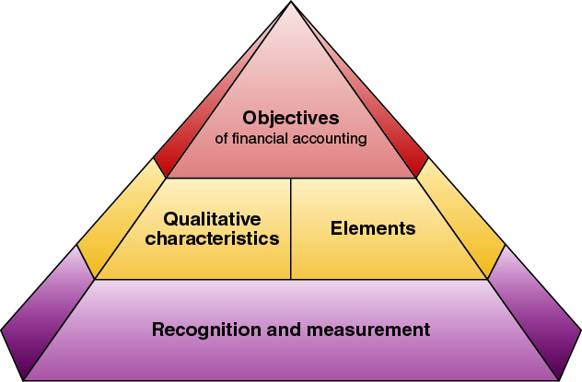
Conceptual Framework (3 of 3)
Learning Objective C4: Explain generally accepted accounting principles and define and apply several accounting principles.

Slide 35
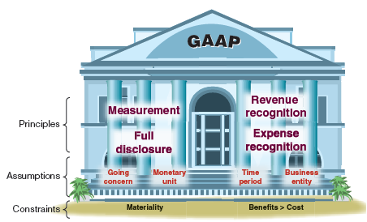
Exhibit 1.7 Principles and Assumptions of Accounting (1 of 2)
Learning Objective C4: Explain generally accepted accounting principles and define and apply several accounting principles.
Notes:
Accounting principles (and assumptions) are of two types. General principles are the basic assumptions, concepts, and guidelines for preparing financial statements. Specific principles are detailed rules used in reporting business transactions and events. General principles stem from long-used accounting practices. Specific principles arise more often from the rulings of authoritative groups.

Slide 36
Exhibit 1.7 Principles and Assumptions of Accounting (2 of 2)
Learning Objective C4: Explain generally accepted accounting principles and define and apply several accounting principles.
General principles are the basic assumptions, concepts, and guidelines for preparing financial statements. General principles stem from long-used accounting practices.
Specific principles are detailed rules used in reporting business transactions and events. Specific principles arise more often from the rulings of authoritative groups.

Slide 37
Accounting Principles (1 of 2)
Learning Objective C4: Explain generally accepted accounting principles and define and apply several accounting principles.
Measurement Principle (or Cost Principle)
Accounting information is based on actual cost. Actual cost is considered objective.
Revenue Recognition Principle
Recognize revenue when it is earned.
Proceeds need not be in cash.
Measure revenue by cash received plus cash value of items received.
Notes:
The measurement principle, also called the cost principle, usually means that accounting information is based on actual cost (with a potential for subsequent adjustments to market). Cost is measured on a cash or equal-to-cash basis. This means if cash is given for a service, its cost is measured as the amount of cash paid.
Three concepts are important to the revenue recognition principle.
Revenue is recognized when earned. The earnings process is normally complete when services are performed or a seller transfers ownership of products to the buyer.
Proceeds from selling products and services need not be in cash. A common noncash proceed received by a seller is a customer’s promise to pay at a future date, called credit sales.
Revenue is measured by the cash received plus the cash value of any other items received.
The expense recognition principle, also called the matching principle, prescribes that a company record the expenses it incurred to generate the revenue reported. The principles of matching and revenue recognition are key to modern accounting.
The full disclosure principle states that a company is required to report the details behind the financial statements if the details so disclosed would impact the users’ decision-making process. Most of the details are reported in the notes to the financial statements.

Slide 38
Accounting Principles (2 of 2)
Learning Objective C4: Explain generally accepted accounting principles and define and apply several accounting principles.
Expense Recognition Principle (or Matching Principle)
A company must record its expenses incurred to generate the revenue reported.
Full Disclosure Principle
A company is required to report the details behind financial statements that would impact users’ decisions.

Slide 39
Accounting Assumptions (1 of 2)
Learning Objective C4: Explain generally accepted accounting principles and define and apply several accounting principles.
Going-Concern Assumption
Reflects assumption that the business will continue operating instead of being closed or sold.
Monetary Unit Assumption
Express transactions and events in monetary, or money, units.
Business Entity Assumption
A business is accounted for separately from other business entities, including its owner.
Notes:
Now we will look at four fundamental assumptions of accounting. The going-concern assumption states that, in the absence of information to the contrary, the business entity is assumed to continue operations into the foreseeable future. The monetary unit assumption tells us that we will only record accounting information that can be expressed in monetary units, usually dollars in the United States. The business entity assumption tells us that we must separate out the transaction of individual owners of a business from those of the business. Finally, the time period assumption presumes that the life of a company can be divided into time periods such as months and years, and that useful reports can be prepared for those periods.

Slide 40
Accounting Assumptions (2 of 2)
Learning Objective C4: Explain generally accepted accounting principles and define and apply several accounting principles.
Time Period Assumption
Presumes that the life of a company
can be divided into time periods,
such as months and years.

Slide 41
Exhibit 1.8 Proprietorship, Partnership, and Corporation
Learning Objective C4: Explain generally accepted accounting principles and define and apply several accounting principles.
Here are some of the major attributes of proprietorships, partnerships, and corporations:
Attribute Present | Proprietorship | Partnership | Corporation
One owner allowed…. | yes | no | yes
Business taxed………… | no | no | yes
Limited liability………… | no* | no* | yes
Business entity………… | yes | yes | yes
Legal entity……………… | no | no | yes
Unlimited life…………… | no | no | yes
*Proprietorship and partnerships that are set up as LLCs provide limited liability.
Notes:
A sole proprietorship, or simply proprietorship, is a business owned by one person. The business is a separate entity for accounting purposes. However, the business is not a separate legal entity from its owner.
A partnership is a business owned by two or more people, called partners, which are jointly liable for tax and other obligations. Like a proprietorship, no special legal requirements must be met in starting a partnership. The only requirement is an agreement between partners to run a business together. The agreement can be either oral or written and usually indicates how income and losses are to be shared. A partnership, like a proprietorship, is not legally separate from its owners.
A corporation, also called a C corporation, is a business legally separate from its owner or owners, meaning it is responsible for its own acts and its own debts. Separate legal status means that a corporation can conduct business with the rights, duties, and responsibilities of a person. A corporation acts through its managers, who are its legal agents. Separate legal status also means that its owners, who are called shareholders (or stockholders), are not personally liable for corporate acts and debts.

Slide 42
Accounting Constraints
Learning Objective C4: Explain generally accepted accounting principles and define and apply several accounting principles.
Materiality
Only information that would influence the decisions of a reasonable person need be disclosed.
Cost-benefit
Only information with benefits of disclosure greater than their cost need be disclosed.
Notes:
There are two basic constraints on financial reporting including the Materiality constraint that prescribes that information that would influence the decisions of a reasonable person need to be disclosed. Both importance and relative size are reviewed.
The Cost-benefit constraint prescribes that only information with benefits which are greater than their costs need to be disclosed.

Slide 43
NEED-TO-KNOW 1-2 Part 1 (1 of 7)
Learning Objective C3: Explain why ethics are crucial to accounting.
Learning Objective C4: Explain generally accepted accounting principles and define and apply several accounting principles.
Identify the following terms/phrases as either an accounting (a) principle, (b) assumption, or (c) constraint.
Materiality
Measurement
Business Entity
Going Concern
Expense Recognition
Time Period
Full Disclosure
Revenue Recognition
Notes:
Identify the following terms/phrases as an accounting principle, assumption, or constraint.

Slide 44
NEED-TO-KNOW 1-2 Part 1 (2 of 7)
Learning Objective C3: Explain why ethics are crucial to accounting.
Learning Objective C4: Explain generally accepted accounting principles and define and apply several accounting principles.
Principles: Govern the amount and/or timing of information to be reported in financial statements.
Measurement principal
Also called the cost principal
Cost is measured on a cash or equal-to-cash basis.
Governs valuation of assets and liabilities on the balance sheet.
Notes:
Principles govern the amount and/or timing of information to be reported in the financial statements. There are four principles.
The measurement principle, which is also called the cost principle, states that cost is measured on a cash or equal-to-cash basis. The measurement principle governs the valuation of assets and liabilities on the balance sheet.
The revenue recognition principle which governs the timing of revenues recognized on the income statement. Revenue is recognized when it's earned, at the time the work is performed.
The expense recognition principle is also called the matching principle. It governs the timing of expenses reported on the income statement. Expenses are recognized in the same time period as the revenues they help generate.
And the full disclosure principle requires that a company must report the details behind financial statements that would impact users' decisions. Disclosures are often in the footnotes to the financial statements.

Slide 45
NEED-TO-KNOW 1-2 Part 1 (3 of 7)
Learning Objective C3: Explain why ethics are crucial to accounting.
Learning Objective C4: Explain generally accepted accounting principles and define and apply several accounting principles.
Revenue recognition principle
Governs the timing of revenues recognized on the income statement.
Revenue is recognized when earned.
Expense recognition principle
Also called the matching principle
Governs the timing of expenses reported on the income statement.
Expenses are recognized in the same time period as the revenues they help generate.

Slide 46
NEED-TO-KNOW 1-2 Part 1 (4 of 7)
Learning Objective C3: Explain why ethics are crucial to accounting.
Learning Objective C4: Explain generally accepted accounting principles and define and apply several accounting principles.
Full disclosure principle
A company must report the details behind financial statements that would impact users' decisions.
Disclosures are often in the footnotes to the financial statements.

Slide 47
NEED-TO-KNOW 1-2 Part 1 (5 of 7)
Learning Objective C3: Explain why ethics are crucial to accounting.
Learning Objective C4: Explain generally accepted accounting principles and define and apply several accounting principles.
Assumptions: Generally related to the financial statement headings.
Going concern assumption
Presumption that the business will continue operating instead of being closed or sold.
Monetary unit assumption
We can express transactions and events in monetary units. (i.e., Dollars, Pesos, Euros)
Notes:
There are four accounting assumptions. And a trick to identifying the assumptions is that we can generally find the information in the financial statement headings.
The first assumption is the going concern assumption. There has been no decision that the business, whose name is reported on the financial statement heading, is going to be closed or sold.
The monetary unit assumption states that we can express transactions and events in monetary units.
The time period assumption presumes that the life of a company can be divided into time periods, and that useful reports can be prepared for those periods.
The business entity assumption states that a business is accounted for separately from other business entities, including its owner.
And there are two constraints. Constraints relate to the reasonableness of the information to be reported. The first constraint is materiality. Materiality states that only information that would influence the decisions of a reasonable person needs to be disclosed. Materiality is a function of the nature of the item and/or the dollar amount. And the benefits must exceed the cost. The benefits of the information disclosed must be greater than the cost of providing the information.

Slide 48
NEED-TO-KNOW 1-2 Part 1 (6 of 7)
Learning Objective C3: Explain why ethics are crucial to accounting.
Learning Objective C4: Explain generally accepted accounting principles and define and apply several accounting principles.
Time period assumption
Presumes that the life of a company can be divided into time periods, and that useful reports can be prepared for those periods.
Business entity assumption
A business is accounted for separately from other business entities, including its owner(s).

Slide 49
NEED-TO-KNOW 1-2 Part 1 (7 of 7)
Learning Objective C3: Explain why ethics are crucial to accounting.
Learning Objective C4: Explain generally accepted accounting principles and define and apply several accounting principles.
Accounting constraints: Reasonableness of information to be reported.
Materiality
Only information that would influence the decisions of a reasonable person needs to be disclosed.
Materiality is a function of the nature of the item and/or dollar amount.
Benefits exceed cost
The benefits of the information disclosed must be greater than the costs of providing the information.

Slide 50
NEED-TO-KNOW Part 1 Solution
Learning Objective C3: Explain why ethics are crucial to accounting.
Learning Objective C4: Explain generally accepted accounting principles and define and apply several accounting principles.
Identify the following terms/phrases as either an accounting (a) principle, (b) assumption, or (c) constraint.
Materiality | c) Constraint
Measurement | a) Principle
Business Entity | b) Assumption
Going Concern | b) Assumption
Expense Recognition | a) Principle
Time Period | b) Assumption
Full Disclosure | a) Principle
Revenue Recognition | a) Principle
Notes:
So, to review: Materiality is a constraint. If an item is so small either in terms of absolute dollar amounts or its nature, the item does not need to be disclosed in the financial statements. Measurement is a principle, Assets and liabilities reported on the balance sheet are valued at cash or the cash equivalent. Business entity is an assumption. Remember, assumptions generally relate to information found in the headings to the financial statements.
The business entity, in this case, is Accounting Today. The financial statements for Accounting Today are separate from other entities, and from the financial statements of the owner. Going concern is also an assumption. There has been no decision that Accounting Today will be closed in the near future. Expense recognition is a principle. Principles govern the dollar amounts and timing of information to be reported on the financial statements. The expense recognition principle, the matching principle, states that expenses are reported in the same time period as the revenues they help generate. Time period is an assumption. The time period is reported in the headings to the financial statements. In this case, the income statement is being reported for the month ended December 31, 2014. Full disclosure is also a principle. Disclosures are reported in the footnotes to the financial statements. And revenue recognition is also a principle. Revenue recognition governs the timing of revenues. The amount of revenue to be reported on the income statement represents the amount of work actually done during the month of December, 2014.

Slide 51
NEED-TO-KNOW 1-2 Part 2
Learning Objective C3: Explain why ethics are crucial to accounting.
Learning Objective C4: Explain generally accepted accounting principles and define and apply several accounting principles.
Complete the following table with either a yes or a no regarding the attributes of a partnership and a corporation.
Attribute Present | Partnership | Corporation
Business taxed | no | yes
Limited liability | no | yes
Legal entity | no | yes
Unlimited life | no | yes

Slide 52
Learning Objective A1: Define and interpret the accounting equation and each of its components.

Slide 53
Transaction Analysis and the Accounting Equation
Learning Objective A1: Define and interpret the accounting equation and each of its components.
The Accounting Equation:
Assets = Liabilities + Equity
Expanded Accounting Equation:
Assets = Liabilities + Contributed Capital + Retained earnings
= Liabilities + Common Stock – Dividends + Revenues – Expenses
(Equity = Contributed Capital + Retained earnings)
(Net income = Revenues – Expenses)
Notes:
The accounting system reflects two basic aspects of a company: what it owns and what it owes. Assets are resources a company owns or controls. Examples are cash, supplies, equipment, and land, where each carries expected benefits. The claims on a company’s assets—what it owes—are separated into owner and non-owner claims. Liabilities are what a company owes its non-owners (creditors) in future payments, products, or services. Equity (also called owner’s equity or capital) refers to the claims of its owner(s). Together, liabilities and equity are the source of funds to acquire assets.
Assets are resources a company owns or controls. These resources are expected to yield future benefits. Examples are Web servers for an online services company, musical instruments for a rock band, and land for a vegetable grower. The term receivable is used to refer to an asset that promises a future inflow of resources. A company that provides a service or product on credit is said to have an account receivable from that customer.
Liabilities are creditors’ claims on assets. These claims reflect company obligations to provide assets, products, or services to others. The term payable refers to a liability that promises a future outflow of resources. Examples are wages payable to workers, accounts payable to suppliers, notes payable to banks, and taxes payable to the government.
Equity is the owner’s claim on assets, and is equal to assets minus liabilities. This is the reason equity is also called net assets or residual equity. Equity is increased by owner investments, called stock issuances, and from revenues. It is decreased by dividends and expenses.
Equity consists of four elements: Contributed capital or common stock; dividends, revenues and expenses. Net income occurs when revenues exceed expenses. Net income increases equity. A net loss o
Review what you have learned in the following NEED-TO-KNOW Slides.

Slide 54
NEED-TO-KNOW 1-3
Learning Objective A1: Define and interpret the accounting equation and each of its components.
Use the accounting equation to compute the missing financial statement amounts.
 | Assets | = | Liabilities | + | Equity
Bose | $150 | = | $30 | + | $120
Vogue | $400 | = | $100 | + | $300
Use the expanded accounting equation to compute the missing financial statement amounts.
 | Assets | = Liabilities | + Equity | + Common Stock | - Dividends | + Revenues | - Expenses
Tesla | $200 | $80 | $120 | $100 | $0 | $60 | ($40)
YouTube | $400 | $160 | $240 | $220 | ($10) | $120 | ($90)
Notes:
Use the accounting equation to compute the missing financial statement amounts. We know that the accounting equations states that total assets must equal the sum of total liabilities plus equity. For Bose Co., $150 of assets equals liabilities of $30 plus equity of $120. For Vogue Co., $100 of liabilities plus $300 of equity equals total assets of $400.
Use the expanded accounting equation to compute the missing financial statement amounts. For Nikon Company, $200 of assets and $80 of liabilities equals equity of $120.
There are four subsets of equity. Equity increases for the amount of common stock and any revenues generated, and equity decreases for any dividends and expenses incurred. Nikon Company has $100 of common stock, no dividends, but incurred $40 of expenses. Total equity for these three components is a total of $60. Since total equity is $120, revenues represent the remaining $60. YouTube has total equity of $240, $400 of assets minus $160 of liabilities. YouTube has $220 of common stock, generated $120 of revenues, and incurred $90 of expenses. $220 plus $120 is $340, minus $90 is $250. Since total equity is only $240, we know that YouTube must have dividends of $10.

Slide 55
Learning Objective P1: Analyze business transactions using the accounting equation.

Slide 56
Transaction 1:
Learning Objective P1: Analyze business transactions using the accounting equation.
Chas Taylor invests $30,000 cash to start a company.
The accounts involved are:
Cash (asset) ↑
Common Stock (equity) ↑
Notes:
Let’s look at the identification and recording of business transactions. We can begin by analyzing a transaction where Chas Taylor forms a consulting business, named FastForward and set up as a corporation. Taylor personally invests thirty thousand dollars cash in the new company and deposits the cash in a bank account opened under the name of FastForward. First, we have to identify the assets, liability or equity accounts involved in this transaction. We can see that the cash account will increase by thirty thousand dollars and the common stock account will also increase by thirty thousand dollars. Let’s see how the books of the company will appear after we record this transaction.

Slide 57
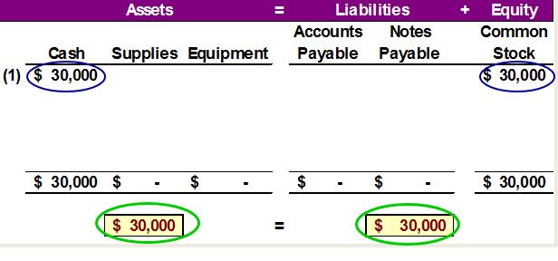
Accounting Equation for Transaction 1:
Learning Objective P1: Analyze business transactions using the accounting equation.
Chas Taylor invests $30,000 cash to start the business, Fast Forward.
Notes:
Here we show the increase in the asset account, cash, and the increase in the equity account, common stock, by thirty thousand dollars. Our basic accounting equation is in balance. Assets have a total balance of thirty thousand dollars and liabilities plus equity have a total balance of thirty thousand dollars. Let’ move on to another transaction.

Slide 58
Transaction 2:
Learning Objective P1: Analyze business transactions using the accounting equation.
Company purchased supplies paying $2,500 cash.
The accounts involved are:
Cash (asset) ↓
Supplies (asset) ↑
Notes:
In this transaction, the company purchases general office supplies by paying two thousand, five hundred dollars cash. The asset account, cash, will decrease by the two thousand, five hundred dollars cash paid. The asset account, supplies, will increase by two thousand, five hundred dollars, the cost of the supplies. In this transaction we are giving up one asset, cash, and receiving another asset, supplies. Let’s look at our books after this transaction is recorded.

Slide 59
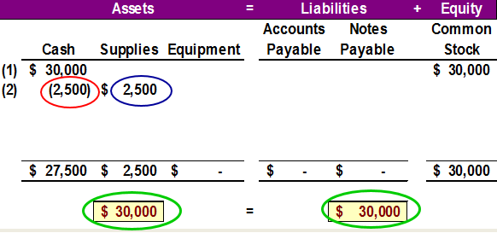
Accounting Equation for Transaction 2:
Learning Objective P1: Analyze business transactions using the accounting equation.
Company purchased supplies paying $2,500 cash.
$ 30,000: Accounting Equation must remain in balance!!
Notes:
We can see the decrease in cash and the increase in supplies. The total assets are still equal to thirty thousand dollars but are divided between cash and supplies. There is no change on the liabilities plus equity section of our books.

Slide 60
Transaction 3:
Learning Objective P1: Analyze business transactions using the accounting equation.
Purchased equipment for $26,000 cash.
The accounts involved are:
Cash (asset) ↓
Equipment (asset) ↑
Notes:
This transaction is similar to the last one we recorded. Here we purchase equipment by paying twenty six thousand dollars cash. The asset account, cash, will decrease by twenty six thousand dollars. The asset account, equipment, will increase by twenty six thousand dollars. Once again, we are exchanging one asset for another. Can you predict what our books will look like after recording this transaction?

Slide 61
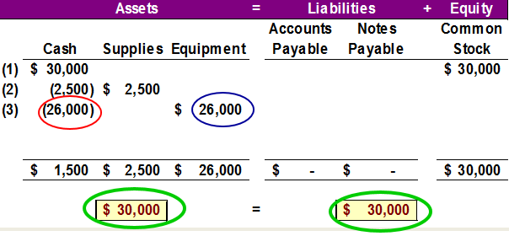
Accounting Equation for Transaction 3:
Learning Objective P1: Analyze business transactions using the accounting equation.
Purchased equipment for $26,000 cash.
$ 30,000: Accounting Equation still remains in balance!!
Notes:
Cash is reduced by twenty six thousand dollars and equipment is increased by twenty six thousand dollars. The balance in our cash account is now one thousand five hundred dollars. We have a current balance in supplies of two thousand five hundred dollars, and equipment of twenty six thousand dollars. The three asset accounts total thirty thousand dollars. Once again, there has been no change in the liabilities plus equity side of the equation.

Slide 62
Transaction 4:
Learning Objective P1: Analyze business transactions using the accounting equation.
Purchased supplies of $7,100 on credit.
The accounts involved are:
Supplies (asset) ↑
Accounts Payable (liability) ↑
Notes:
In this transaction, the company purchases supplies seventy one hundred dollars on credit. We do not pay cash, but agree to pay off the account at some point in the future. The asset account, supplies increases by seventy one hundred dollars and the liability account, accounts payable, increases by seventy one hundred dollars as well. Let’s see what our books look like now.

Slide 63
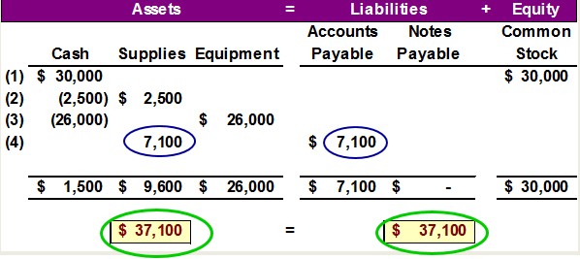
Accounting Equation for Transaction 4:
Learning Objective P1: Analyze business transactions using the accounting equation.
Purchased Supplies of $7,100 on credit.
$ 37,100: Accounting Equation still remains in balance!!
Notes:
You can see the balance in the cash, supplies and equipment accounts. The total on the asset side of the equation is thirty seven thousand, one hundred dollars. We acquired the assets without paying cash. If you use a credit card to purchase gas for your car, you receive an asset, gas, and incur an account payable to the credit card company. The balance in the liabilities accounts is now seventy one hundred dollars, and the common stock account balance is still thirty thousand dollars.

Slide 64
Transaction Analysis
Learning Objective P1: Analyze business transactions using the accounting equation
Now, let’s look at transactions involving revenues, expenses and dividends.
Notes:
To this point, we have not looked at transactions involving revenues, expenses, and dividends. In the next few slides we will address these accounts.

Slide 65
Transaction 5:
Learning Objective P1: Analyze business transactions using the accounting equation.
Provided consulting services to a customer and received $4,200 cash right away.
The accounts involved are:
Cash (asset) ↑
Revenues (equity) ↑
Notes:
The company rendered consulting services to a customer receiving forty two hundred dollars cash in full payment. The asset account, cash, will increase by forty two hundred dollars. The equity account, revenues, will also increase by the same amount. Let’s look at our expanded book balances.

Slide 66
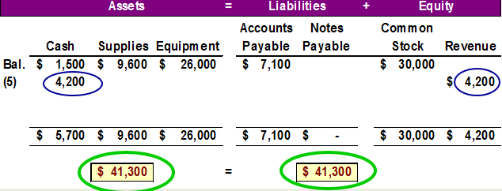
Accounting Equation Transaction 5:
Learning Objective P1: Analyze business transactions using the accounting equation
Provided consulting services to a customer and received $4,200 cash right away.
Notes:
You see that our cash account increases by forty two hundred dollars, to a current balance of five thousand seven hundred dollars. Total assets amount to forty one thousand, three hundred dollars. The revenue account also increased by forty two hundred dollars. Recall that from our expanded accounting equation that revenues increase equity and expenses decrease equity. The total of our liabilities plus equity is now forty one thousand, three hundred dollars.

Slide 67
Transactions 6 and 7:
Learning Objective P1: Analyze business transactions using the accounting equation.
Paid rent of $1,000 and salaries of $700 to employees.
The accounts involved are:
Cash (asset) ↓
Rent expense ↑ (equity) ↓
Salaries expense ↑ (equity) ↓
Remember that the balance in the Expense accounts actually increase.
But, total Equity decreases, because expenses reduce equity.
Notes:
The company paid cash rent of $1,000 and cash salaries of $700 to employees. The asset account, cash, decreases by one thousand seven hundred dollars. The equity account, rent expense increases by $1,000 and salaries expense increases by $700. Remember, an increase in an expense account will decrease total equity. Do you think you can get this transaction recorded properly in our books?

Slide 68
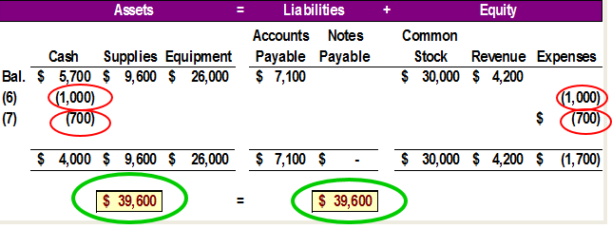
Accounting Equation Transactions 6 and 7:
Learning Objective P1: Analyze business transactions using the accounting equation.
Paid rent of $1,000 and salaries of $700 to employees.
Remember that expenses decrease equity.
Notes:
How did you do? You got the decrease in the cash account, but did you remember to show the increase in expenses as a decrease in total equity. Our expanded equation is getting to look more and more complicated. Don’t worry, practice will help you fully understand the recording of these and similar transactions. Our books are still in balance.

Slide 69
Transaction 8:
Learning Objective P1: Analyze business transactions using the accounting equation.
Provided consulting services of $1,600 and rents facilities for $300 to a customer for credit.
The accounts involved are:
Accounts receivable (asset) ↑
Consulting Revenues (equity) ↑
Rental Revenue (equity) ↑
Notes:
The company provided consulting services of $1,600 and rented its test facilities for $300 to a customer. The asset account, Accounts receivable, will increase by $1,900. The equity account, Consulting revenue will increase by $1,600 and the equity account Rental Revenue, will also increase by the $300. Let’s look at our expanded book balances.

Slide 70
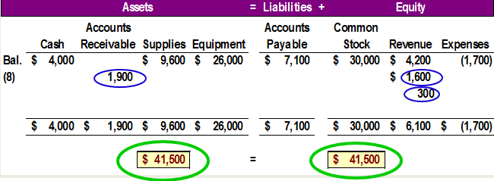
Accounting Equation for Transaction 8:
Learning Objective P1: Analyze business transactions using the accounting equation.
Provided consulting services of $1,600 and rents facilities for $300 to a customer for credit.
Notes:
Our expanded equation is getting to look more and more complicated. Don’t worry, practice will help you fully understand the recording of these and similar transactions. Our books are still in balance.

Slide 71
Transaction 9:
Learning Objective P1: Analyze business transactions using the accounting equation.
Client in transaction 8 pays $1,900 for consulting services.
The accounts involved are:
Cash (asset) ↑
Accounts receivable (asset) ↓
Notes:
The client in transaction 8 pays $1,900 10 days after it is billed for consulting services.

Slide 72
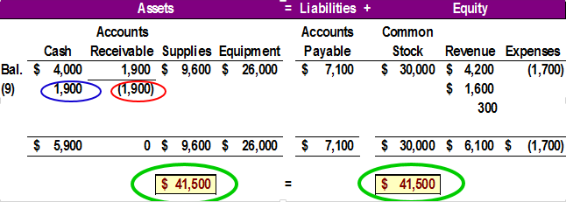
Accounting Equation for Transaction 9:
Learning Objective P1: Analyze business transactions using the accounting equation.
Client in transaction 8 pays $1,900 for consulting services.
Notes:
The client in transaction 8 pays $1,900 10 days after it is billed for consulting services. The total amount of assets remains the same, and liabilities and equity remain the same as well.

Slide 73
Transaction 10:
Learning Objective P1: Analyze business transactions using the accounting equation.
FastForward pays $900 as partial payment for supplies purchased in transaction 4.
The accounts involved are:
Cash (asset) ↓
Accounts payable (liability) ↓
Notes:
FastForward pays $900 as partial payment for its earlier purchase of supplies purchased in transaction 4 leaving $6,200 balance unpaid.

Slide 74
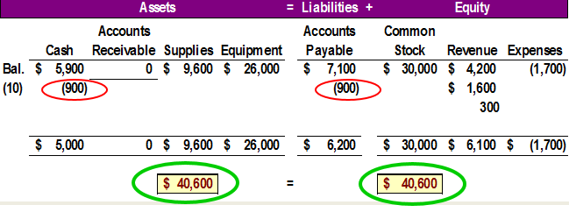
Accounting Equation for Transaction 10:
Learning Objective P1: Analyze business transactions using the accounting equation.
FastForward pays $900 as partial payment for supplies purchased in transaction 4.
Notes:
FastForward pays $900 as partial payment for its earlier purchase of supplies purchased in transaction 4 leaving $6,200 balance unpaid in its Accounts payable account.

Slide 75
Transaction 11:
Learning Objective P1: Analyze business transactions using the accounting equation.
Dividends of $200 are paid to shareholders.
The accounts involved are:
Cash (asset) ↓
Dividends (equity) ↑
Remember that the Dividend account actually increases (just like our Expenses account . . . )
But, total Equity decreases because dividends cause equity to go down !!
Notes:
FastForward declares and pays a $200 cash dividend to its owner (the sole shareholder). The company’s cash account decreased by $200. The equity account, Dividends, increased by $200. Once again, refer back to the expanded accounting equation and you will see that dividends decrease total equity.

Slide 76
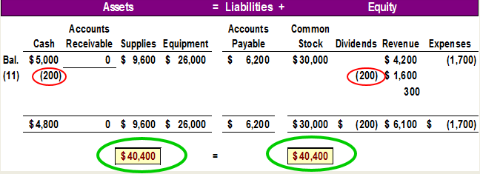
Accounting Equation for Transaction 11 :
Learning Objective P1: Analyze business transactions using the accounting equation.
Dividends of $200 are paid to shareholders.
Notes:
The company’s cash account decreased by $200. The equity account, Dividends, increased by $200.

Slide 77
NEED-TO-KNOW 1-4 (1 of 2)
Learning Objective P1: Analyze business transactions using the accounting equation.
Assume Tata Company began operations on January 1 and completed the following transactions during its first month of operations.
Jan. 1 | Jamsetji invested $4,000 cash in the Tata company in exchange for its common stock.
Jan. 5 | The company purchased $2,000 of equipment on credit.
Jan. 14 | The company provided $540 of services for a client on credit.
Jan. 21 | The company paid $250 cash for an employee’s salary
Arrange the following asset, liability, and equity titles in a table: Cash; Accounts Receivable; Equipment; Accounts Payable; Common Stock; Dividends; Revenues; and Expenses.
Notes:
Assume Tata began operations on January 1 and completed the following transactions during its first month of operations. Arrange the following asset, liability, and equity titles in a table: Cash; Accounts Receivable; Equipment; Accounts Payable, Common Stock; Dividends; Revenues; and Expenses. The assets include Cash, Accounts receivable, and Equipment. Accounts Payable is a liability. Equity includes four subsets.
Equity increases as a result of common stock and any revenues generated. Equity decreases as a result of dividends and expenses incurred. On Jan. 1, Jamsetji invested $4,000 cash in the Tata Company in exchange for its common stock. This transaction increases both assets and equity. We increase the asset, Cash, by $4,000, and we increase equity by increasing the balance in the Common Stock account. On Jan. 5, the company purchased $2,000 of equipment on credit. Whenever we see the term "on credit,” we know that it's not a cash transaction; instead, it was charged. This transaction increases both assets and liabilities. We increase the asset, Equipment, by $2,000, and increase the liability, Accounts Payable, by the same amount. This transaction has no impact on equity. On Jan. 14, the company provided $540 of services for a client on credit. Again we see the term "on credit,” so this was not a cash customer, it's a credit customer. The transaction increases both assets and equity. We record the growth in assets by increasing the balance in Accounts Receivable by $540, and we increase equity by recording $540 of revenues. On Jan. 21, the company paid $250 cash for an employee’s salary. This transaction decreases both assets and equity. We decrease the asset, Cash, by $250, and decrease equity by recording a $250 expense. Expenses always reduce equity. At the end of January, the company has $3,750 of Cash, $540 of Accounts Receivable, and $2,000 of Equipment; total assets, $6,290. Total liabilities include Accounts Payable of $2,000. We can calculate total equity by subtracting the $2,000 of liabilities from the $6,290 of assets. Total equity is $4,290. This is equal to the balance in the Common Stock account, $4,000, plus the balance in the Revenues, $540, minus the Dividends of $0, minus the Expenses of $250. Total equity is $4,290.

Slide 78
NEED-TO-KNOW 1-4 (2 of 2)
Learning Objective P1: Analyze business transactions using the accounting equation.
 |  | Assets | = | Liabilities |  |  | + Equity
 | Cash | Accounts Receivable | Equipment | Accounts Payable | + Common Stock | - Dividends | + Revenues | -Expenses
Jan. 1 | $4,000 |  |  |  | $4,000
Jan. 5 |  |  | $2,000 | $2,000
Jan. 14 |  | $540 |  |  |  |  | $540
Jan. 21 | ($250) |  |  |  |  |  |  | ($250)
 | $3,750 | $540 | $2,000 | $2,000 | $4,000 | $0 | $540 | ($250)
Total Assets | $6,290
Total Liabilities | $2,000
Total Equity | $4,290

Slide 79
Learning Objective P2: Identify and prepare basic financial statements and explain how they interrelate.

Slide 80
Financial Statements (1 of 2)
Learning Objective P2: Identify and prepare basic financial statements and explain how they interrelate.
The four financial statements and their purposes are:
Income statement — describes a company’s revenues and expenses along with the resulting net income or loss over a period of time due to earnings activities.
Statement of retained earnings— explains changes in equity from net income (or loss) and from any dividends over a period of time.
Notes:
This section introduces us to how financial statements are prepared from the analysis of business transactions. The four financial statements and their purposes are:
Income statement — describes a company’s revenues and expenses along with the resulting net income or loss over a period of time due to earnings activities.
Statement of retained earnings— explains changes in equity from net income (or loss) and from any dividends over a period of time.
Balance sheet — describes a company’s financial position (types and amounts of assets, liabilities, and equity) at a point in time.
Statement of cash flows — identifies cash inflows (receipts) and cash outflows (payments) over a period of time.
Review what you have learned in the following NEED-TO-KNOW Slides.

Slide 81
Financial Statements (2 of 2)
Learning Objective P2: Identify and prepare basic financial statements and explain how they interrelate.
Balance sheet — describes a company’s financial position (types and amounts of assets, liabilities, and equity) at a point in time.
Statement of cash flows — identifies cash inflows (receipts) and cash outflows (payments) over a period of time.
Notes:
This section introduces us to how financial statements are prepared from the analysis of business transactions. The four financial statements and their purposes are:
Income statement — describes a company’s revenues and expenses along with the resulting net income or loss over a period of time due to earnings activities.
Statement of retained earnings— explains changes in equity from net income (or loss) and from any dividends over a period of time.
Balance sheet — describes a company’s financial position (types and amounts of assets, liabilities, and equity) at a point in time.
Statement of cash flows — identifies cash inflows (receipts) and cash outflows (payments) over a period of time.
Review what you have learned in the following NEED-TO-KNOW Slides.

Slide 82
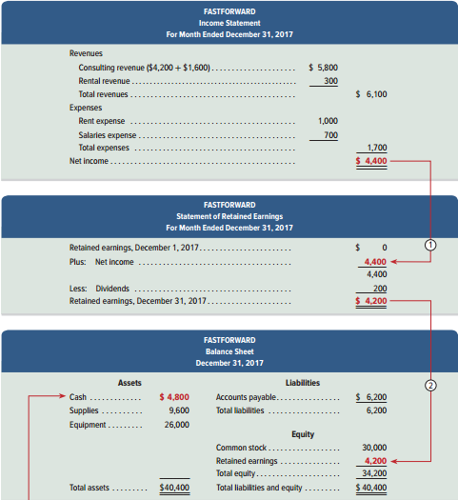
Exhibit 1.10 Financial Statements and Their Links (1 of 2)
Learning Objective P2: Identify and prepare basic financial statements and explain how they interrelate.
Notes:
Financial Statements and Their Links.
Income Statement for FastForward includes revenues of $6,100 and expenses which total $1,700 for a Net Income of $4,400.
The Statement of Retained Earnings has a beginning Retained earnings balance of 0, adds the net income of $4,400 from the Income Statement, and subtracts Dividends of $200 for an ending Retained earnings balance of $4,200.
The Balance Sheet shows total assets of $40,400 and total liabilities and equity of $40,400. Notice that the ending Retained earnings balance from the Statement of Retained Earnings of $4,200 is brought forward into the Equity section of the Balance sheet and added to the $30,000 Common stock balance for total equity of $34,200. Adding the total liabilities of $6,200, we get Total liabilities and equity of $40,400.

Slide 83
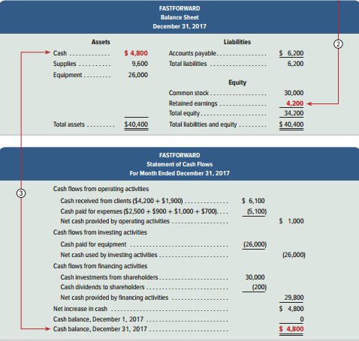
Exhibit 1.10 Financial Statements and Their Links (2 of 2)
Learning Objective P2: Identify and prepare basic financial statements and explain how they interrelate.
Notes:
The FastForward’s statement of cash flows is the final report in Exhibit 1.10. The first section reports cash flows from operating activities. It shows the $6,100 cash received from clients and the $5,100 cash paid for supplies, rent, and employee salaries. Outflows are in parentheses to denote subtraction. Net cash provided by operating activities for December is $1,000.
The second section reports investing activities, which involve buying and selling assets such as land and equipment that are held for
long-term use (typically more than one year). The only investing activity is the $26,000 purchase of equipment.
The third section shows cash flows from financing activities, which include long-term borrowing and repaying of cash from lenders and the cash investments from, and dividends to stockholders. FastForward reports $30,000 from the owner’s initial investment and a $200 cash dividend. The net cash effect of all financing transactions is a $29,800 cash inflow. The final part of the statement
shows an increased cash balance of $4,800. The ending balance is also $4,800 as it started with no cash—see line 3. Statement of cash flows identifies the cash inflows (receipts) and cash outflows (payments) over a period of time.

Slide 84
NEED-TO-KNOW 1-5 (1 of 3)
Learning Objective P2: Identify and prepare basic financial statements and explain how they interrelate.
Prepare the (a) income statement, (b) statement of retained earnings, and (c) balance sheet, for Apple using the following condensed data from its fiscal year ended September 26, 20X2.
Accounts payable | $35,490
Other liabilities | 135,634
Cost of sales (expense) | 140,089
Cash | 21,120
Retained earnings, September 29, 20X1 | 87,152
Dividends in fiscal year 20X2 | 48,262
Revenues | 233,715
Investments and other assets | $230,039
Land and equipment | 22,471
Selling and other expense | 40,232
Accounts receivable | 16,849
Net income | 53,394
Retained earnings, September 26, 20X2 | 92,284
Common stock | 27,071
Notes:
Prepare the (a) income statement, (b) statement of retained earnings, and c) balance sheet, for Apple using the following condensed data from its fiscal year ended September 26, 20x2. Every account is an asset, a liability, or a subset of equity. There are four subsets of equity. Common stock and revenues increase equity, and dividends and expenses decrease equity. Each asset account, along with its balance, appears directly on the balance sheet. Each liability account, along with its balance, will also appear on the balance sheet. The amount of common stock in the current period appears on the balance sheet and are added in the equity section. Dividends during the period are subtracted on the statement of retained earnings. Each revenue account, along with its balance, appears on the income statement. And each expense account, along with its balance, appears on the income statement as a reduction in net income. The final amount reported on the income statement is net income or net loss; total revenues minus total expenses. The amount of net income or loss is transferred to the statement of retained earnings. Net income is added to the retained earnings balance and net losses are subtracted from retained earnings. The final amount reported on the statement of retained earnings is the retained earnings ending balance. This balance is reported on the balance sheet.

Slide 85
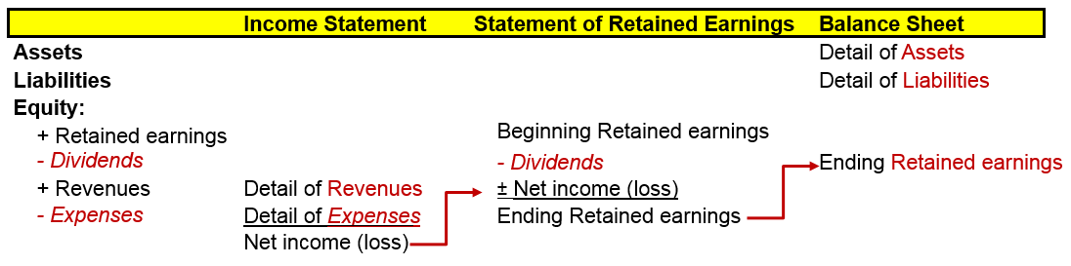
NEED-TO-KNOW 1-5 (2 of 3)
Learning Objective P2: Identify and prepare basic financial statements and explain how they interrelate.

Slide 86
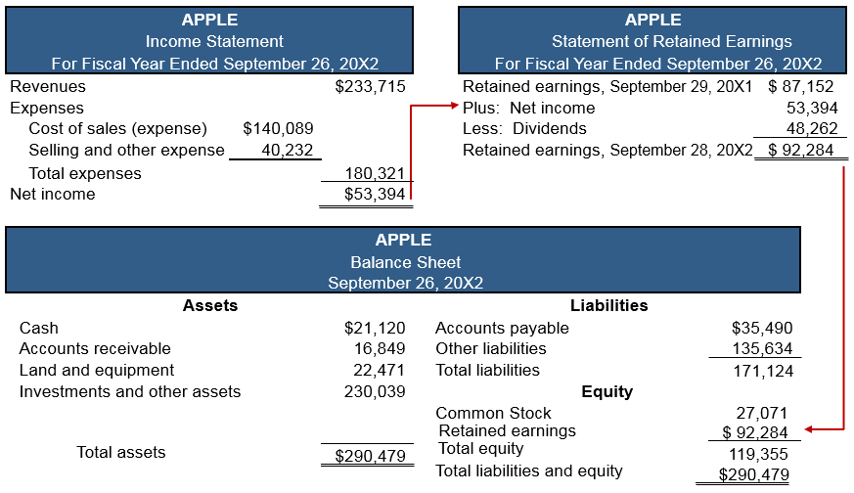
NEED-TO-KNOW 1-5 (3 of 3)
Learning Objective P2: Identify and prepare basic financial statements and explain how they interrelate.
Notes:
So now let's prepare the financial statements. The balance sheet is the accounting equation; Assets = Liabilities + Equity. And every amount given ultimately appears on the balance sheet, either in detail (the assets and liabilities) or as a summarized amount, total equity. So let's use each of the account balances to prepare the financial statements. Accounts payable and Other liabilities are liability accounts. Liabilities appear on the balance sheet. Cost of sales is an expense. Expenses appear on the income statement. Cash is an asset; assets appear on the balance sheet. The beginning balance in the retained earnings account appears on the statement of retained earnings. Dividends are subtracted on the statement of retained earnings. Revenues appear on the income statement.
Investments and other assets appear on the balance sheet, along with the assets, land and equipment. Selling and other expense appears on the income statement. Accounts receivable is an asset. We're told that net income is $53,394.
Total revenues, $233,715 minus total expenses of $180,321, agrees with net income, given at $53,394. The amount of net income is transferred from the income statement to the statement of retained earnings and added to the retained earnings beginning balance. Retained earnings, at the beginning of the year, $87,152, plus net income, $53,394, minus the amount of dividends, $45,586, equals the retained earnings ending capital balance, $92,284. This summarized equity amount, the ending retained earnings balance, is transferred to the balance sheet. All four subsets of equity are now included on the balance sheet. Revenues and expenses have flowed from the income statement to the statement of retained earnings. Net income has been added to the retained earnings balance. Dividends have been subtracted from the retained earnings balance, and the ending retained earnings balance flows to the balance sheet. Total assets are $290,479; total liabilities; $171,124; and total equity is $119,355. Total liabilities and equity, $290,479. Our accounting equation, the balance sheet, is in balance.

Slide 87
Sustainability and Accounting
Sustainability Accounting Standards Board (SASB)
Nonprofit entity engaged in creating and disseminating sustainability accounting standards for companies.
Sustainability refers to environmental, social and governance.
Environmental aspects include programs to reduce pollution and support green activities.
Standards intended to complement financial accounting standards.
SASB created their own Conceptual Framework.
Notes:
Sustainability Accounting Standards Board (SASB)
Nonprofit entity engaged in creating and disseminating sustainability accounting standards for companies.
Sustainability refers to environmental, social and governance. Social aspects include donations to hospitals, colleges, etc.
Environmental aspects include programs to reduce pollution and support green activities.
These standards intended to complement financial accounting standards. SASB has created their own Conceptual Framework to guide the development of sustainability standards. It has also developed a set of principles which provide a minimum criteria.

Slide 88
Learning Objective A2: Compute and interpret return on assets.

Slide 89
Return on Assets
Learning Objective A2: Compute and interpret return on assets.
Return on assets (ROA) is stated in ratio form as net income divided by the average total assets invested.
Fiscal Year | Return on Assets: Verizon | Return on Assets: Industry
2015………………….. | 7.7% | 4.8%
2014………………….. | 4.7 | 4.1
2013…………………… | 9.4 | 5.4
2012…………………… | 4.6 | 3.3
2011…………………… | 4.5 | 3.1
Notes:
This chapter presents a profitability measure: return on assets. Return on assets is useful in evaluating management, analyzing and forecasting profits, and planning activities. Dell has its marketing department compute return on assets for every order. Return on assets (ROA), also called return on investment (ROI), is defined as net income divided by total average assets.
Net income is from the annual income statement, and average total assets is computed by adding the beginning and ending amounts for that same period and dividing by 2.
Verizon shows a fairly stable pattern of good returns that reflect its productive use of assets. There is a higher than usual return in 2013 reflecting some unusual items. We compare Verizon’s return to the normal return for similar manufacturers of computers (third column). We compute industry norms from services such as Dun & Bradstreet’s Industry Norms and Key Ratios and The Risk Management Association Annual Statement Studies. When compared to the industry, Verizon often performs slightly better.

Slide 90
Learning Objective A3 (Appendix 1A): Explain the relation between return and risk.

Slide 91
Exhibit 1A.1 Appendix 1A Return and Risk Analysis (1 of 2)
Learning Objective A3: Explain the relation between return and risk.
Many different returns may be reported.
ROA
Interest return on savings accounts.
Interest return on corporate bonds.
Risk is the uncertainty about the return we will earn.
Notes:
Net income is often linked to return. Return on assets (ROA) is stated in ratio form as income divided by assets invested. For example, banks report return from a savings account in the form of an interest return such as 4%. If we invest in a savings account or in U.S. Treasury bills, we expect a return of around 1% to 5%. How do we decide among these investment options? The answer depends on our trade-off between return and risk.
Risk is the uncertainty about the return we will earn. All business investments involve risk, but some investments involve more risk than others. The lower the risk of an investment, the lower is our expected return. The bar graph shows recent returns for 10-year bonds with different risks. Bonds are written promises by organizations to repay amounts loaned with interest. U.S. Treasury bonds provide a low expected return, but they also offer low risk since they are backed by the U.S. government. High-risk corporate bonds offer a much larger potential return but with much higher risk.

Slide 92
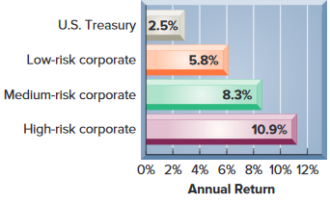
Exhibit 1A.1 Appendix 1A Return and Risk Analysis (2 of 2)
Learning Objective A3: Explain the relation between return and risk.
The lower the risk, the lower our expected return.

Slide 93
Learning Objective C5 (Appendix 1B): Identify and describe the three major activities of organizations.

Slide 94
Appendix 1B Business Activities and the Accounting Equation (1 of 5)
Learning Objective C5: Identify and describe the three major activities of organizations.
Three major types of business activities:
Financing activities provide the means organizations use to pay for resources such as land, buildings, and equipment to carry out plans.
Owner financing—resources contributed by the owner along with any income the owner leaves in the organization.
Notes:
There are three major types of business activities.
Financing activities provide the means organizations use to pay for resources such as land, buildings, and equipment to carry out plans. Organizations are careful in acquiring and managing financing activities because they can determine success or failure. The two sources of financing are owner and nonowner. Owner financing refers to resources contributed by the owner along with any income the owner leaves in the organization. Nonowner (or creditor) financing refers to resources contributed by creditors (lenders). Financial management is the task of planning how to obtain these resources and to set the right mix between owner and creditor financing.

Slide 95
Appendix 1B Business Activities and the Accounting Equation (2 of 5)
Learning Objective C5: Identify and describe the three major activities of organizations.
Nonowner financing—resources contributed by creditors (lenders).
Financial management —the task of planning how to obtain these resources and to set the right mix between owner and creditor financing.

Slide 96
Appendix 1B Business Activities and the Accounting Equation (3 of 5)
Learning Objective C5: Identify and describe the three major activities of organizations.
Investing activities are the acquiring and disposing of resources (assets) that an organization uses to acquire and sell its products or services.
Asset management—determining the amount and type of assets for operations.
Assets—invested amounts.
Liabilities—creditors’ claims.
Equity—owner’s claim.
Notes:
Investing activities are the acquiring and disposing of resources (assets) that an organization uses to acquire and sell its products or services. Assets are funded by an organization’s financing. Organizations differ on the amount and makeup of assets. Some require land and factories to operate. Others need only an office. Determining the amount and type of assets for operations is called asset management. Invested amounts are referred to as assets. Financing is made up of creditor and owner financing, which hold claims on assets.
Creditors’ claims are called liabilities, and the owner’s claim is called equity.

Slide 97
Appendix 1B Business Activities and the Accounting Equation (4 of 5)
Learning Objective C5: Identify and describe the three major activities of organizations.
Operating activities involve using resources to research, develop, purchase, produce, distribute, and market products and services.
Strategic management—the process of determining the right mix of operating activities for the type of organization, its plans, and its market.
Notes:
Investing activities are the acquiring and disposing of resources (assets) that an organization uses to acquire and sell its products or services. Assets are funded by an organization’s financing. Organizations differ on the amount and makeup of assets. Some require land and factories to operate. Others need only an office. Determining the amount and type of assets for operations is called asset management. Invested amounts are referred to as assets. Financing is made up of creditor and owner financing, which hold claims on assets.
Creditors’ claims are called liabilities, and the owner’s claim is called equity.

Slide 98
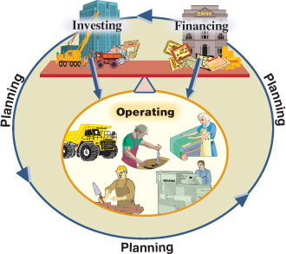
Appendix 1B Business Activities and the Accounting Equation (5 of 5)
Learning Objective C5: Identify and describe the three major activities of organizations.
Exhibit 1B.1
Activities of Organizations
Notes:
This illustration summarizes business activities. Planning is part of each activity and gives them meaning and focus. Investing (assets) and financing (liabilities and equity) are set opposite each other to stress their balance. Operating activities are below investing and financing activities to show that operating activities are the result of investing and financing.

Slide 99
End of Presentation

